Slide 1
Adaptive Clocking Techniques for SoC Supply Droop Response in Predictive 7nm CMOS
Dan Fritchman, Wahid Rahman
EE241B Final Project
May 4, 2020

Slide 2
Overview
Motivation
Adaptive Clocking Schemes
PLL-based adaptive clocking
Adaptive Clock Distribution (ACD)
PLL-based Adaptive Clocking in ASAP7
Simulation Results
Summary

Slide 3
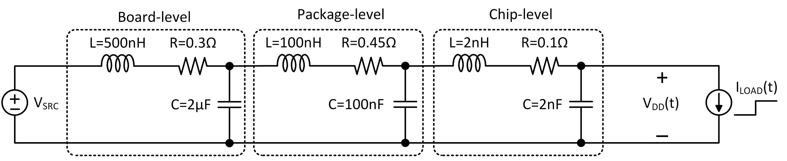
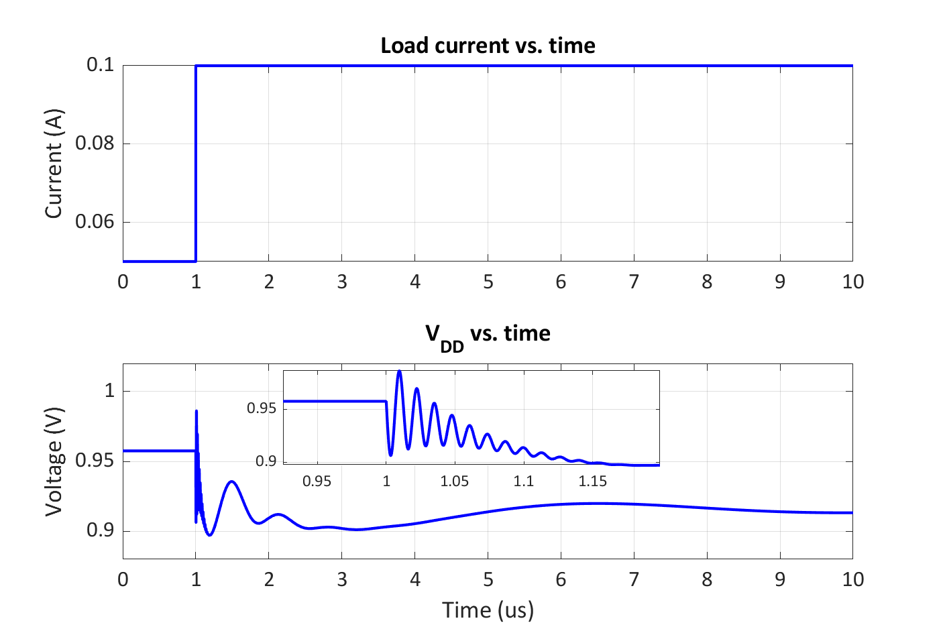
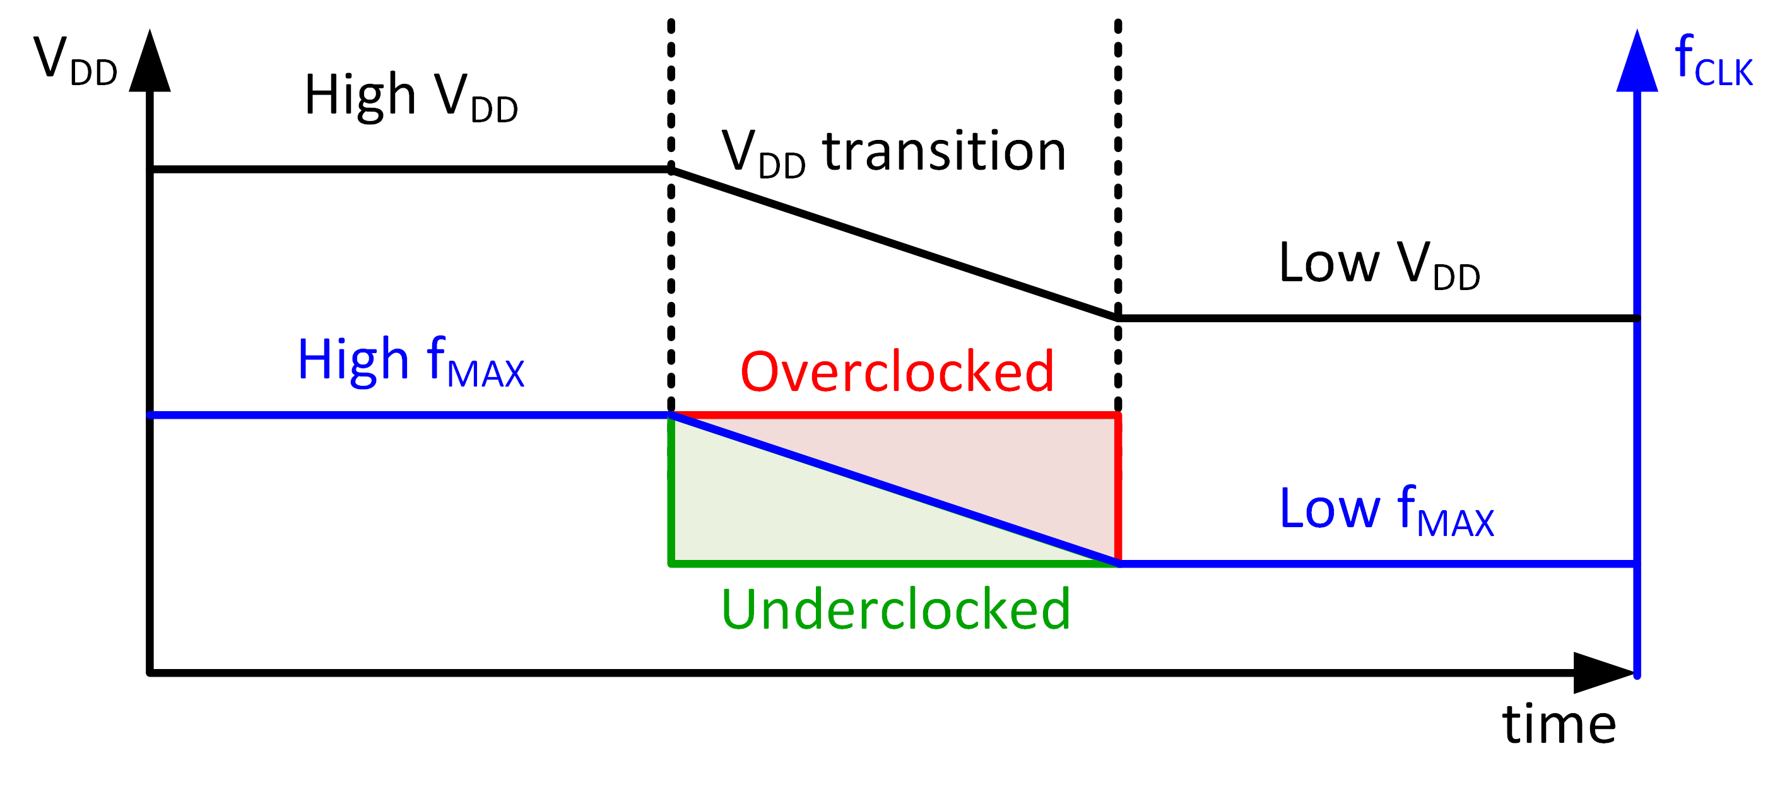

Motivation
Adapted from F. Ahmad et al. JSSC 2017
Adapted from T. Hashimoto et al. JSSC 2015
Power management in modern SoCs can enable/disable multiple cores, causing surge currents
Surge currents cause supply droops through L$\frac{di}{dt}$ ripples from power distribution network
Objective: Adapt SoC clocking in response to supply droops with minimal guardbanding

Slide 4
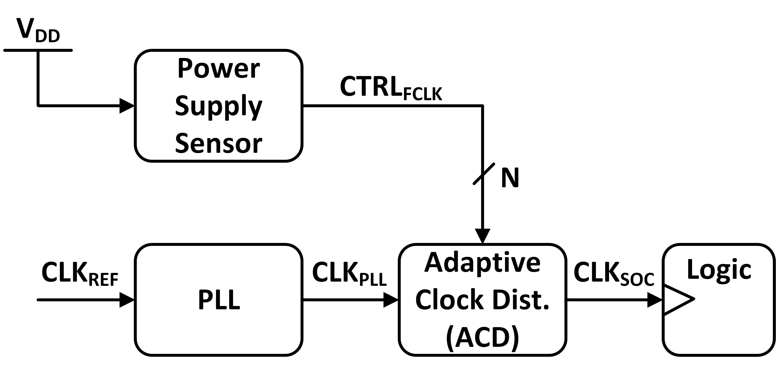
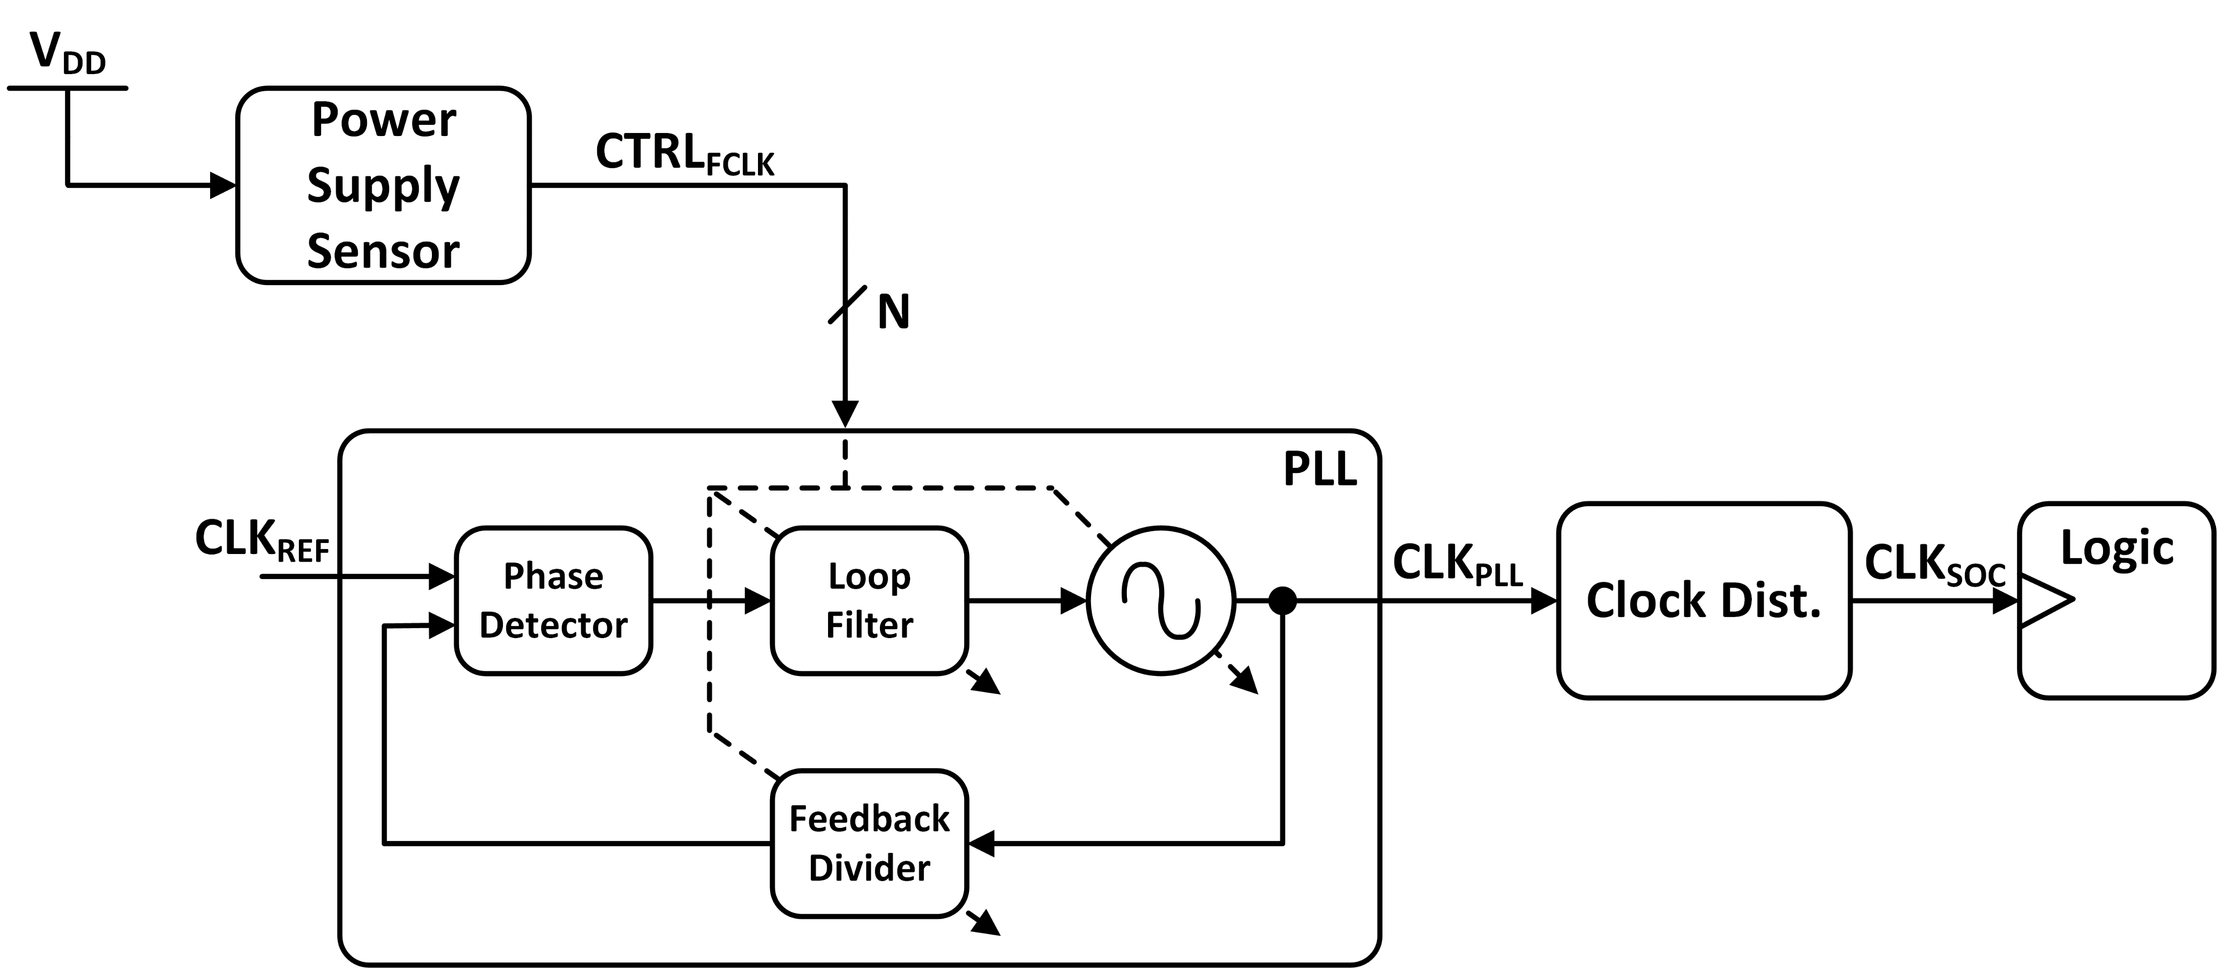
Adaptive Clocking Schemes

